Slide 1
Chongqing University of Technology
ATAI
Advanced Technique of Artificial Intelligence
Chongqing University of Technology
Multi-View Sequence-to-Sequence Models with Conversational Structure for Abstractive Dialogue Summarization （2020_EMNLP）
Jiaao Chen
School of Interactive Computing
Georgia Institute of Technology,
Diyi Yang
School of Interactive Computing
Georgia Institute of Technology
2020.12.18 • ChongQing
Reported by Lele Duan
Code:https://github.com/GT-SALT/ Multi-View-Seq2Seq.

Slide 2
Chongqing University of Technology
ATAI
Advanced Technique of Artificial Intelligence
Chongqing University of Technology
1.Introduction
2.Method
3.Experiments

Slide 3
Introduction
Much attention has been paid to summarizing structured text
Summarizing conversations where most important pieces of information are scattered is still under-investigated
Prior work also largely ignored diverse conversational structures in dialogues

Slide 4
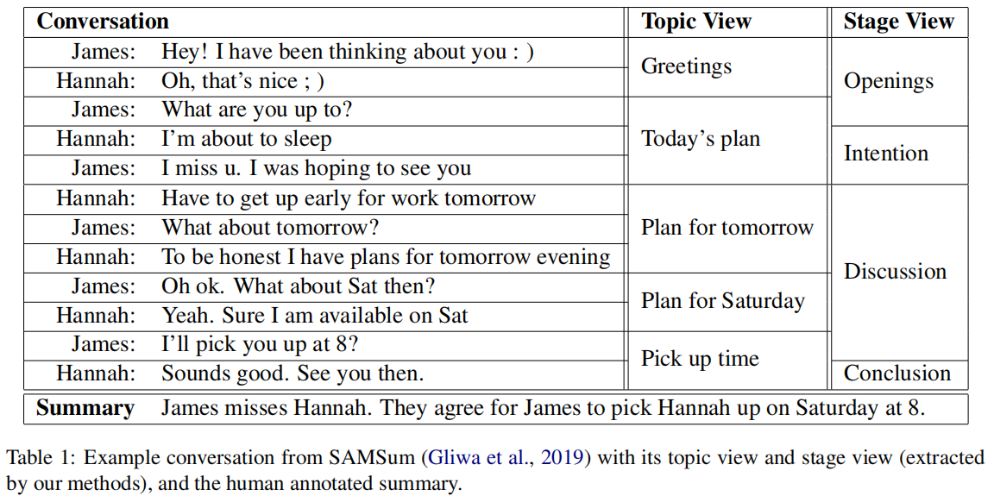
Method
This work proposes a multi-view sequence-to sequence model
Firstly extract different views of structures from conversations.
Then encodes them to generate summaries

Slide 5
Method
Extract topic view
Conversation
$$\{h_{1},h_{2},…,h_{m}\}$$
2000
Extract stage view
Conversation
$$\{h_{1},h_{2},…,h_{m}\}$$
2016
Global View and Discrete View
A global view that concatenates all utterances into one giant block
A discrete view that separates each utterance into a distinct block

Slide 6
Method
Model

Slide 7
Method
Conversation Encoder
LSTM
A special token
$S_{j}^{k}$ describing each block $j$,

Slide 8
Method
Multi-view Decoder

Slide 9
Experiment

Slide 10
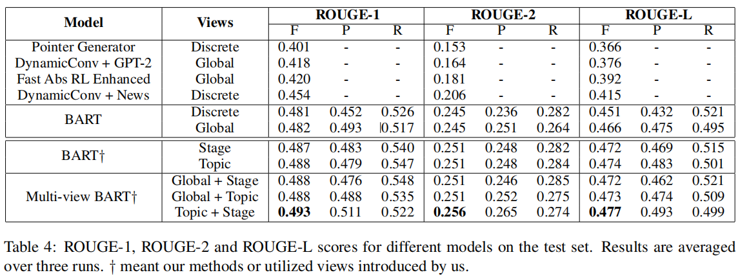
Experiment

Slide 11
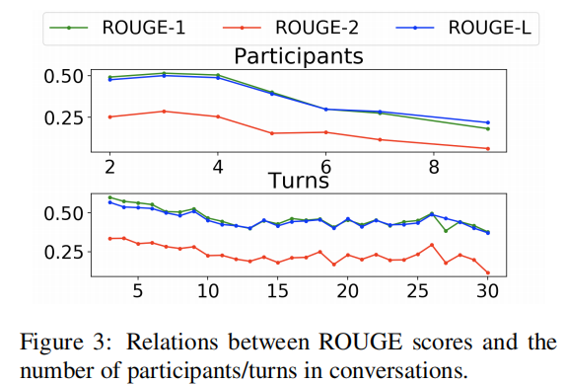
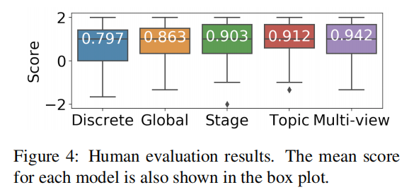
Experiment

